Slide 1
Hand Gesture Recognition Model
CAPSTONE PROJECT
Presented By:
1. Nitin Hingwe – Ujjain Engineering College – Chemical Engineering Department

Slide 2
OUTLINE
Problem Statement (Should not include solution)
Proposed System/Solution
System Development Approach (Technology Used)
Algorithm & Deployment
Result
Conclusion
Future Scope
References

Slide 3
Problem Statement
Hand gesture recognition (HGR) is a subarea of Computer Vision focusing on classifying a video or image containing dynamic or static hand gestures. The challenge is to create a reliable system that can accurately interpret and classify different hand gestures, such as a fist, palm, or thumbs up, using captured images or videos. This capability is essential for applications in human-computer interaction, sign language translation, and other areas requiring gesture-based control.

Slide 4
Proposed Solution
The proposed system aims to address the challenge of accurately classifying hand gestures using a deep learning algorithm. This involves the following components:
Data Collection: Utilize the Hand Gesture Recognition Database available on Kaggle, containing 6000 images from 3 individuals with 10 different hand gestures.
Data Preprocessing: Clean and preprocess the collected data to handle variations in image quality and consistency. Perform feature extraction to highlight relevant aspects of the hand gestures.
Machine Learning Algorithm: Implement a Convolutional Neural Network (CNN) to classify hand gestures based on the preprocessed data. The CNN will be trained to recognize patterns and features unique to each gesture.
Model Training and Evaluation: Train the CNN using labeled hand gesture images and evaluate its performance using appropriate metrics such as accuracy.
Deployment: Save the trained model and deploy it in an application capable of real-time hand gesture recognition. This application will provide predictions and allow for interaction based on recognized gestures.

Slide 5
System Approach
System Requirements:
A computer with a GPU for faster training
Python environment
Internet access to download datasets and libraries
Libraries Required to Build the Model:
OpenCV: For image processing and video capture
Keras: For building and training the CNN model
Mediapipe: For additional hand gesture detection and preprocessing
TensorFlow: As the backend for Keras and for additional deep learning functionalities

Slide 6
Algorithm & Deployment
Algorithm Selection:
Convolutional Neural Network (CNN) is chosen for its effectiveness in image classification tasks. CNNs are suitable due to their ability to automatically and adaptively learn spatial hierarchies of features from input images.
Data Input:
The input features include images of hand gestures from the dataset, preprocessed to standardize size and quality.
Training Process:
The CNN is trained using the labeled hand gesture images. The training involves multiple epochs, where the model learns to minimize the loss function and improve accuracy through backpropagation and gradient descent.
Prediction Process:
The trained model makes predictions on new hand gesture images. The model processes the input image through its learned filters and layers to classify the gesture.

Slide 7
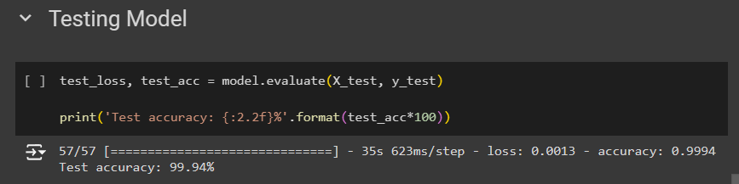
Result
The CNN model achieved an impressive accuracy in recognizing hand gestures. The evaluation on the test dataset showed the following results: Accuracy:
The model's predictions were highly accurate, with a test accuracy of 99.94%, demonstrating its effectiveness in hand gesture recognition.

Slide 8
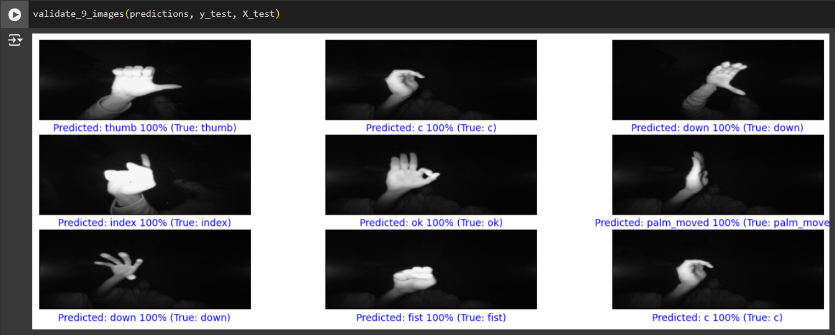
Result
Predictions:

Slide 9
Conclusion
The project successfully developed a hand gesture recognition model with high accuracy, capable of classifying various hand gestures using deep learning techniques. The system can be deployed in real-time applications, providing reliable gesture-based interactions. Challenges included ensuring data quality and managing computational resources during training. Future improvements could involve expanding the dataset, incorporating more complex gestures, and optimizing the model for real-time performance.

Slide 10
Future scope
Interacting with Computers: Enhancing remote control capabilities for devices using hand gestures.
Sign Language Translation: Improving communication tools for individuals with hearing impairments by expanding gesture vocabularies.
Integration with Emerging Technologies: Utilizing edge computing for faster, localized processing and exploring advanced machine learning techniques for improved accuracy and robustness.

Slide 11
References
TensorFlow: TensorFlow Tutorials - Used for understanding CNN.
Keras: Keras Conv2D Documentation - Used for understanding the Conv2D layer.
Kaggle: Hand Gesture Recognition Dataset - Used for the dataset.
My GitHub Project Repository: https://github.com/nitinhingwe/Hand-Gesture-Recognition-Model.git

Slide 12
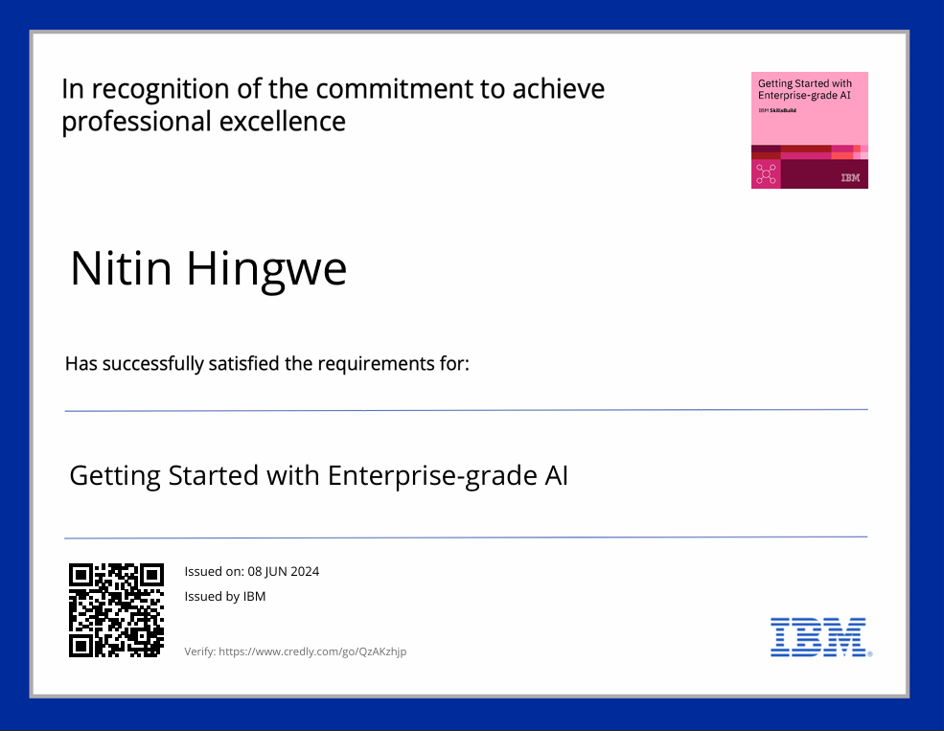
course certificate 1

Slide 13
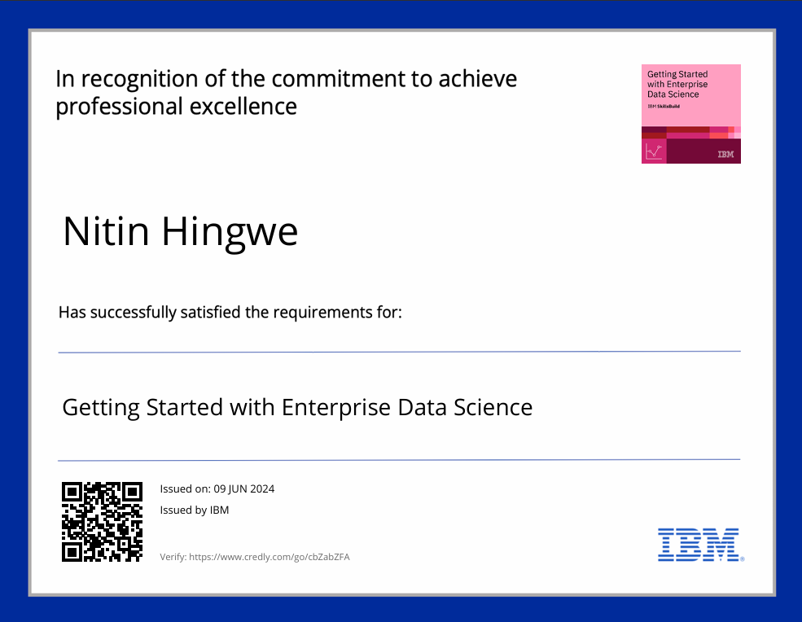
course certificate 2

Slide 14
THANK YOU

